Slide 1
SAGE Training for administrators
April
2015
Research & Assessment
Canyons School District

Slide 2
SAGE TRAINING TOPICS
Key Concepts for Administrators
Special Codes, Spanish-English Dictionary, Accountability Qs, Testing Times, Participation, Test Tools
Testing Ethics
Accommodations, Resources, and ELL Students
Entering Accommodations
Content Specific Questions

Slide 3
Key concepts for administrators

Slide 4
Special Codes
Special codes are used for non-standard situations and non-participants.
A blank test will be interpreted as “not participating”, unless a special code is identified for the test.
Special codes are audited for appropriate use. ALL student data will be used for scoring, reporting, and accountability.

Slide 5
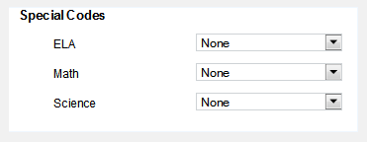
RECORDING Special Codes Several new codes
Absent
ELL first year in US April 15 or later
ELL first year in US before April 15
UAA
Student Refuses to Test
Excused – Medical Emergency
Course Instruction Incomplete
Course Instruction Not Provided
Test has already been taken
Unfixable UTREx Error
Accommodated
Modified (uncommon)
Parent Opt Out
The Special Codes fields may be selected for each subject’s test. The Special Codes are mutually exclusive
Note: If you select a special code (other than accommodated or modified), the student will not be eligible for any test in that subject.
Note: Parent Opt Out vs. Student Refuses to Test
Notes:
The Special Codes box displays the special codes for the selected student. The Special Codes can be viewed as two types; non-participation and participation.
For non-participation codes (absent, withdrawn, UAA, etc.), once they are set, the student will not be eligible to start any tests in that subject. If this code was set in error, an authorized user can go to TIDE and reset the code. Once complete, the student will again be eligible for tests in that subject.
Note: if a student had already started a test and should not be participating (ex. the student started the test but should be taking the alternative assessment) then use the Create Invalidation tab to invalidate the test.

Slide 6
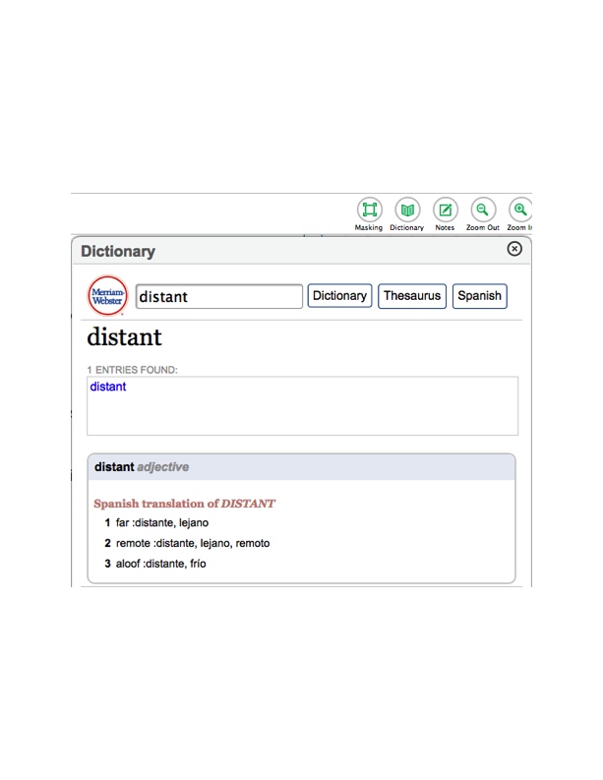
Student Dictionary & Thesaurus English and Spanish
All students for all SAGE tests will have access to an online dictionary. It is also available in the training test.
NEW: The dictionary provides an English to Spanish/Spanish to English translation.
2015 USOE Policy: ESL students whose primary home language is not Spanish may use other language translation dictionaries, either paper or electronic. The electronic bilingual dictionary cannot access the internet (not Wi-Fi enabled)

Slide 7
Spring Writing Reminder
Any student who has not yet logged in to the SAGE Writing assessment section of ELA will be able to complete writing during the spring testing window.
These new move in students will receive prompts from 2014 and will have instant scoring.
All February writing responses have now been hand scored.

Slide 8
Immediate SAGE Scores
For math and science, students will receive their scale score and proficiency level on screen immediately after they Submit Test for scoring. See screenshot below.
For ELA, scores will be provided in the SAGE Online Results System (ORS) once each student completes both the writing, reading, listening and literacy sections. The scores appear in ORS by the next morning.
NOTE: SAGE Results can no longer be used as part of student grades! See Friday memo on 4/3/2015

Slide 9
Basic Accountability Questions
What is Full Academic Year? 160 days of school membership
What about frequently absent students? They are included in accountability for the school and teacher
Does the 160 days also apply for teacher accountability of MSGP? No. However they need to be a the school for 160 days.
Are the UAA/DLM students included in accountability? Yes.

Slide 10
Testing TIME ESTIMATES
Each student must be given sufficient time to complete each SAGE Summative test
Mathematics
Elementary and Secondary = 90 minutes
English Language Arts - ELA
Reading, Listening and Language Section
Elementary – approx. 90 minutes
Secondary – approx. 90 minutes
Science
Elementary and Secondary – 90 minutes

Slide 11
Testing TIME - Sessions
All tests may be split among multiple testing sessions/class periods
Students may pause the test at any time
TIMEOUT RULE: Questions cannot be viewed or modified after test is paused for 20 minutes or inactive for 30 minutes.
Students will begin on day 2, where they left on day 1
Students will NOT be able to change answers on previous day’s work
Students should be allowed adequate time to complete each test. SAGE tests are not timed.

Slide 12
Participation RULE
Students must answer 6 items to count as a participant (accountability).
Students must complete the test to be scored.
There is a new category of tests called, participated but unscored. These students are given credit for participating but have an unscored test.

Slide 13
Test Tools
All students have the ability to:
Highlight text in passages and test questions
Zoom in and out of test pages (this makes the font look larger or smaller)
Mark specific items for review
Strikethrough (cross out answer options)
Use the Formula Sheet, Notepad, or Calculator depending on the test
Use the Expand button to display a reading passage or a science simulation
Listen to Text-to-Speech audio in the test questions.
Notes:
All students have the ability to do the following:
Highlight text in passages and test questions
Zoom in and out of test pages, which makes the font look larger or smaller
Mark specific items for review
Strikethrough (cross out answer options)
Use the Formula Sheet, Notepad, or Calculator depending on the test
Use the Expand button to display more of a reading passage or science scene

Slide 14
Test Management - District
Done in TIDE by District or USOE.
Invalidate Student Test – Delete test. This is rare. It could be done in instances of student cheating.
Reset Test – Permanently deletes all student work. The school administrator would need to make a written request to Research and Assessment. This is rare.

Slide 15
Testing Ethics

Slide 16
TESTING ETHICS PROCEDURES for Administrators
Adminstrators are required to provide training for standard test administration and testing ethics procedures to all educators involved in testing.
The following activities must occur before SAGE Summative
Provide testing ethics (you) and test administration training (Ed Tech). For ethics training, use the PDF presentation produced by USOE titled “Standard Test Administration Testing Ethics”.
Make sure you have on file a 2014-15 signed form from each educator involved in testing.
Fill out and return the accompanying “Principal’s Testing Procedure Checklist” form to Hal Sanderson, Research and Assessment, on or before June 1st, 2015.

Slide 17
Testing Ethics
Educators may not examine test content, including passages, questions, or answer options, at any time. Under no circumstances should actual passages, prompts or questions from these tests be taught to or reviewed with students.
Reproducing the test via electronic or paper means is not permitted.
Educators may not read passages, questions, or answer options to a student.

Slide 18
Appropriate Teaching Practices
Ethical testing begins with ethical teaching
Ensure that students are enrolled in the appropriate course so that they receive appropriate instruction.
Provide instruction on the entire curriculum for a course.
Provide accommodations during instruction to eligible students.

Slide 19
Appropriate Teaching Practices
During testing:
All students are given the correct test.
Information from the TAM is followed exactly.
Accommodations are provided to eligible students.
Appropriate Proctoring Includes:
The importance of the test, test participation.
The good faith efforts from all students is not undermined!
Active proctoring – move around, etc.

Slide 20
SAGE Accommodations for IEP, 504 or Ell students.

Slide 21
RESOURCES & ACCommodations
Accommodations are practices and procedures that provide equitable access during instruction and assessments for special needs students that do not alter the validity of the assessment, score interpretation, reliability or security of the assessment.
Accommodations are intended to reduce or even eliminate the effects of a student’s disability; they do not reduce learning expectations.
Resources are best practices that are provided for all students, including students in general education and special needs students. Extended time, breaks, and use of an alternative location are examples of resources which may be used by all students.
A large majority of Accommodations in 2013 (presentation, response, setting, timing) are now classified as Resources this year. Resources are allowed for all students and built into SAGE.

Slide 22
Scribe student does not need an IEP or 504
A student who experiences a debilitating injury just prior to testing that prevents him or her from being able to write may need a scribe. Scribes must have experience and understanding of how to effectively scribe for a student.
The Scribe Guidelines and procedures can be found on the USOE Assessment website at: http://www.schools.utah.gov/assessment/Special-Needs/ScribeGuidelines.aspx
A student does not need an IEP or 504 to receive Scribe services. See the above guidelines

Slide 23
Accommodation: American Sign Language
Allowed for English language arts listening passages which have an embedded video of a human signing for students with disabilities with USOE authorization. Human signing on any portion of the ELA, Math or Science assessments is not allowed except for directions.
If human sign is allowed on the assessment, only a certified interpreter may sign statewide assessments.

Slide 24
Accommodation: Large Print / Standard Sized Paper
Large Print: All text and graphic materials, including labels and captions on pictures, diagrams, maps, charts, exponential numbers, notes, and footnotes, must be presented in at least 18-point type for students who need large print.
Standard size paper: available on request for students with disabilities. On request, standard size paper can be provided at student’s school.

Slide 25
Accommodation: Braille & TACTILE GRAPHICS
We ask that they notify us if it is being used, but do not require approval or a list of the students who are requesting the accommodation. (Need USOE Authorization)
Prints tactile representations of graphics using an external embosser printer. USOE needs to be contacted for this accommodation.

Slide 26
SAGE RESOURCES: Access for all students
Feature | Description | SAGE Availability
Alternate Location | An alternate location for the student that will help minimize distractions during testing. (Alternate locations will vary depending on the needs of the student.) | Allowed
Alternate Text and Background Colors | Changes the color used to display text and graphics and the color used for the background on which text and graphics are displayed | Allowed
Assistive Communication Devices | Allows a student to navigate and interact with the system using the Tab/Enter keys and/or equivalent on an alternative/assistive communication device | Embedded
Audio Amplification | Audio amplification devices to help increase clarity for the student. | Allowed
Breaks | Breaks may be given if needed. The assessment must not be discussed or research during the break. | Allowed

Slide 27
SAGE RESOURCES: Access for all students
Feature | Description | Availability
Calculation Devices | Provided online for items where the construct of the item is not violated. The calculators used by SAGE will be available to be downloaded for free for instructional use. | Embedded; depends on grade
Change in the Order of Activities | To reduce fatigue and increase attention, activities or some tests can be administered over multiple days – completing a portion each day. | Allowed
Color Adjustments | Students may choose the font and background color combinations that help them perceive text-based content including reverse contrast such as white font on a black background. | Embedded
Directions – Oral Translation | Oral translation of directions involves immediate rendering of directions into a student’s native language. Clarification of directions is not allowed on any assessment. | Allowed
Directions – reread | To accurately understand the task a student is being asked to engage in, some students need to have directions reread. Clarification of directions is not allowed on any assessment. | Not allowed; embedded

Slide 28
SAGE RESOURCES: Access for all students
Feature | Description | Availability
Directions – Signed | Directions may be signed by an interpreter. Clarification of directions is not allowed for any student. | Allowed with interpreter
Environment | Environmental changes may be necessary for some students. | Allowed
Highlight | Allows text to be highlighted | Embedded
Human Reader | Human read aloud of text may or may not be allowed on assessments. | Not allowed; use text-to-speech
Increased Font Size | Allows students to increase the size of alphanumeric content and images | Allowed

Slide 29
SAGE RESOURCES: Access for all students
Feature | Description | Availability
Magnification | Magnifies a selected portion of an item including text and graphics | Embedded
Minimize Distractions | A student may wear noise buffers, such as earphones, earplugs, or headphones, to reduce distractions and improve concentration. Study carrels may also be used. | Allowed
Reverse Contrast | Reverses the colors used to display text and graphics and the background on which text and graphics are displayed | Allowed
Scratch Paper | Students may use blank scratch paper. | Allowed
Spell Check | On assessments, spell check or word prediction may or may not be available and only available on items that would not violate the construct of the item. | Embedded

Slide 30
SAGE RESOURCES: Access for all students
Feature | Description | Availability
Strike Through | Allows students to strike out answers they have eliminated as possible correct answers | Embedded
Text-to-Speech | Allows text-based content to be presented in spoken form | Embedded

Slide 31
Entering Accommodations
Research & Assessment
Canyons School District

Slide 32
TWO WAYS to View Student Info
1) In TIDE – Test Information Distribution Engine
The TIDE interface uses tabs as the principal means of navigating between tasks. Some tasks in the TIDE interface contain multiple sub-tasks.
2) In Test Administration (Next Slides)
Both can be accessed by

Slide 33
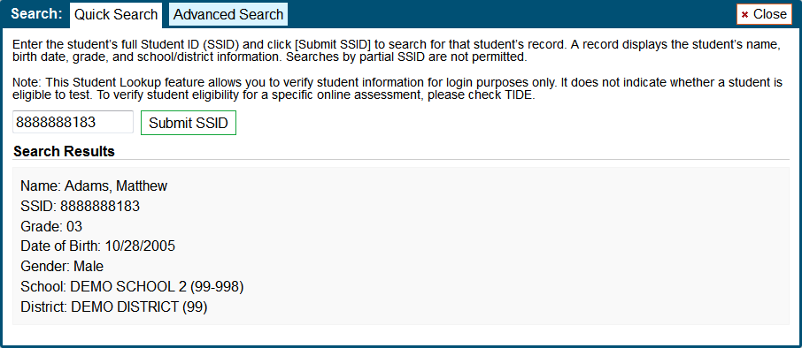
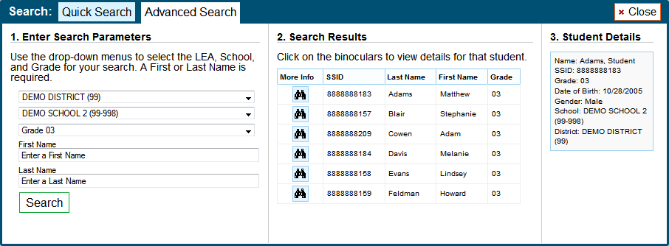
In Test Administration: Student Lookup & Resources
Notes:
If a student is having trouble logging in, you can use the Student Lookup feature to search for that student by SSID number or first or last name. This feature should be used only to verify a student’s name or SSID. Ensure the student is logging in with his or her first name exactly as it appears in TIDE, instead of a middle name or nickname.
Any incorrect student information in the required demographic fields must be updated in your district SIS system and then uploaded to UTREx. Updates to student information submitted will be reflected in TIDE within 96 hours. After a student’s record is updated in TIDE, he or she can begin testing.
For a Quick Search by SSID, click the [Student Lookup] button in the top row of the Test Administrator Interface. Enter a student’s SSID number. Click [Submit SSID]. If the search produces a match, that student’s information will be shown.
For an Advanced Search, click the [Student Lookup] button, and then click the [Advanced Search] tab. Select a district and school from the drop-down lists. Select a specific grade or “all grades.” Enter a student’s first name and/or last name if you are looking for a particular student. Partial names are allowed (e.g., enter “Fi” into the last name field to search for students whose last name begins with “Fi”). You can also complete the search without entering in a student’s name. Click [Search]. If the search results in matches, the information will be displayed in the second column. To see more information about a student, click the binoculars icon next to his or her name. A third column showing the student’s information will appear.

Slide 34
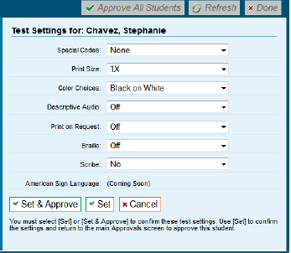
Test Administration: Test Settings & Accommodations
Select the appropriate option for each test setting, if needed.
Confirm the settings.
Click [Set] to confirm the selected test settings and return to the list of students awaiting approval.
Click [Set & Approve] to establish the updated settings and approve the student for testing.
Click [Cancel] if you want to return to the Approvals and Student Test Settings screen.
Special Codes
Notes:
Students’ default test settings and accommodations can be set in TIDE or can be set when approving a student for the session.
Please review each student’s information to ensure that he or she has the correct test settings and accommodations. The appropriate test settings and accommodations must be selected for these students before they can start testing. The Braille setting cannot be modified after a student begins a test. Changing the Braille setting will request a test reset and student progress will be lost from the initial test. Please ensure the TA computer or device is connected to a printer for administering tests to students who will need the Print on Request test setting set to [on].
Select the appropriate option for each test setting, if needed. Confirm the settings. Click [Set] to confirm the selected test settings and return to the list of students awaiting approval. You will still have to approve the student for testing. Click [Set & Approve] to establish the updated settings and approve the student for testing. Click [Cancel] if you want to return to the Approvals and Student Test Settings screen.

Slide 35
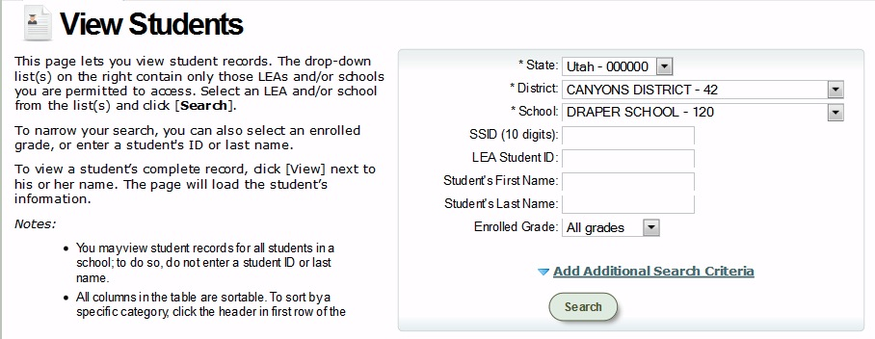
IN TIDE: View Students
To search for existing student records, select the sub-tab [View Students].
To help narrow results, search by first name, last name, and/or grade.
You can click on Add Additional Search Criteria to search by birth date and/or non-grade-based test eligibility.
Click the [Search] button after all search criteria has been selected/entered.
Notes:
Before you can view or edit a user record, you must search for a student or students.
To search for existing student records, select the sub-tab View Students.
You can view only those students who are associated with the test administration selected at the time of login.
Select a school from the drop-down menus. The state and district/LEA will already be populated based on the user’s log in credentials.
To help narrow results, search by first name, last name, LEA Student ID and/or grade. You can also click on the Add Additional search criteria to search by birth date and/or non-grade based test eligibility.
Click the [Search] button after all search criteria have been selected/entered.

Slide 36
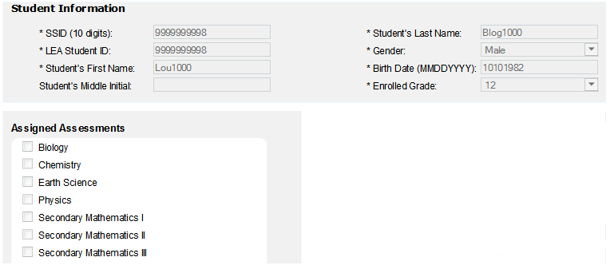
IN TIDE: View Students
The Student Information and Assigned Assessments boxes contain student information and course-based test assignments for the selected student.
This information is read-only and changes must be made in the SKYWARD system to be uploaded to the UTREx system and on to TIDE.
Updates to student information should be reflected in TIDE within 3-4 days of the change being made.
Notes:
The Student Information box contains the information for the selected student. This information is read only.
Any changes to student data must be made in your district SIS system and uploaded to the UTREx system. Updates to student information will be reflected in TIDE within 96 hours.

Slide 37
View Student: Accommodations Codes
The Accommodations Code fields may be selected for each subject’s test.
Print on Request
Braille
Scribe
American Sign Language
Notes:
The Special Codes box displays the special codes for the selected student. The Special Codes can be viewed as two types; non-participation and participation.
For non-participation codes (absent, withdrawn, UAA, etc.), once they are set, the student will not be eligible to start any tests in that subject. If this code was set in error, an authorized user can go to TIDE and reset the code. Once complete, the student will again be eligible for tests in that subject.
Note: if a student had already started a test and should not be participating (ex. the student started the test but should be taking the alternative assessment) then use the Create Invalidation tab to invalidate the test.

Slide 38
Guidelines for assessment of English Learners
2014-15 Utah participation & accommodation policy (There are no policy changes)

Slide 39
current school year and who are new to the United States
English Learners (EL) who have been enrolled in a school in the United States less than three years may be exempt from some assessments. The following guidelines must be followed:
EL students enrolled on or after April 15 of the current school year and who are new to the United States (first year of enrollment in any U.S. school) are exempt from all state tests.
EL students enrolled during the current school year before April 15 and who are new to the United States (first year of enrollment in any U.S. school) must take:
WIDA Access
Math SAGE Summative (counted for participation only; scores are not calculated for Accountability).
Science SAGE Summative (not counted in any Accountability calculation).

Slide 40
enrolled during the previous school year
EL students enrolled on or after April 15 of the previous school year must take:
WIDA.
Math SAGE Summative (counted for participation only; scores are not calculated for Accountability).
Science SAGE Summative (not counted in any Accountability calculation).
EL students who enrolled during the previous school year before April 15 must take:
WIDA.
ELA SAGE Summative.
Math SAGE Summative.
Science SAGE Summative.
Grades 1-3 Reading DIBELS. Note: ELA SAGE, Math SAGE, Science SAGE, are used for Accountability calculations.

Slide 41
Students enrolled Three or More Years
EL students enrolled three or more years must take:
WIDA
ELA & Writing SAGE Summative.
Math SAGE Summative.
Science SAGE Summative.
Grades 1-3 Reading DIBELS.
Note: ELA SAGE, Math SAGE, and Science SAGE scores are used for accountability calculations.

Slide 42
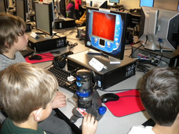
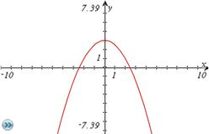
CONTENT SPECIFIC QUESTIONS

Slide 43
ELA and Literacy
Reading
Single and Paired Passages
Literary/Informational ratio follows Core
Listening
Short (1 min) passages: dialogue, discussion, etc.
Headphones
Language
Edit draft passage of student writing

Slide 44
Mathematics
Grades 3 - 8, Secondary I, Secondary II, Secondary III
All items aligned to the Utah Core Standards
Range of DOK and Elements of Rigor across all Domain, Clusters, and Standards

Slide 45
Mathematics
Grades 3 - 5: Calculator NOT allowed.
Not available on screen
Cannot bring in their own
Based on the Utah State Standards and students in these grades needing to build basic computation skills and knowledge
Grade 6: Calculator allowed on certain items.
Available ONLY onscreen
Cannot bring in their own
Available on items related to specific standards. Those standards are still being determined.

Slide 46
Mathematics
Reference sheets will no longer be available or necessary for the grades 3-6 Elementary Math SAGE.
Any standard, that is appropriate for students to have a formula to solve an item, will have the formula embedded in the item.
Standards that state: “Apply the formula”

Slide 47
Secondary Mathematics
Reference sheets will no longer be available or necessary for Secondary Math SAGE.
Any item that is appropriate for students to have a formula, will have the formula embedded in the item.
Calculator will be available on the test
Student may bring in and use a calculator that was used during classroom instruction
No phone or internet capable calculators are permitted!

Slide 48
secondary mathematics
Secondary Calculator Usage
Students may use any calculator previously used during instruction (with the exception of a phone or internet capable device.)
An on-screen calculator is also available.
In 6th grade an onscreen calculator can be used on certain test questions. It will depend on the Core Curriculum Standard. Students cannot bring their own calculator.

Slide 49
MATHematics Reference Sheet
Reference sheets will not be available or necessary for Elementary or Secondary.
In 6th grade if a formula is needed, it will be embedded in the problem.
In 7 – 11, if a formula is needed to solve the problem, the formula may or may not be given depending on the Core Curriculum standard.

Slide 50
Math Formula Charts
If I have formula charts (core standards instructional aides) up in my room do I need to take them down for the test?
Students should not be provided with any assistance that would elevate their score. Charts and posters that would help students take the test should be covered or taken down.

Slide 51
Science
All items aligned to a Standard, Objective, and ILOs
DOK 1-4 items spread across all Standards and Objectives
Developing for a 40%-60% split between Multiple Choice and Constructed Response items for each student
Simulations allow for in-depth, experiment-like conditions allowing assessment of science skills in a setting approximating authenticity

Slide 52
Science
Calculators allowed for all tests
Students may use a calculator they are familiar with
A scientific calculator will be provided as an on-line tool
No phone or internet capable calculators are permitted!
Reference sheets are available for Chemistry and Physics
Download and use throughout the year if you desire
http://www.schools.utah.gov/assessment/Adaptive-Assessment-System/Science.aspx

